Slide 1
Building a data pipeline to analyze structured and unstructured, archived and streaming data
TEAM- Bigdata Ninjas(BDN-11)

Slide 2
Loading of Streaming Data from Twitter into Big Query Table
Creation of Bucket for storing live streaming flight data
Creation of Cloud function to extract data from Open-Sky API and to store data in the Bucket
Creation of Pub/Sub Topic
Creation of Steaming Dataflow Job to move the data from Bucket to Pub/Sub
Creation of Table in Big Query
Creation of Streaming Dataflow job to move the data from Pub/Sub to Big Query

Slide 3
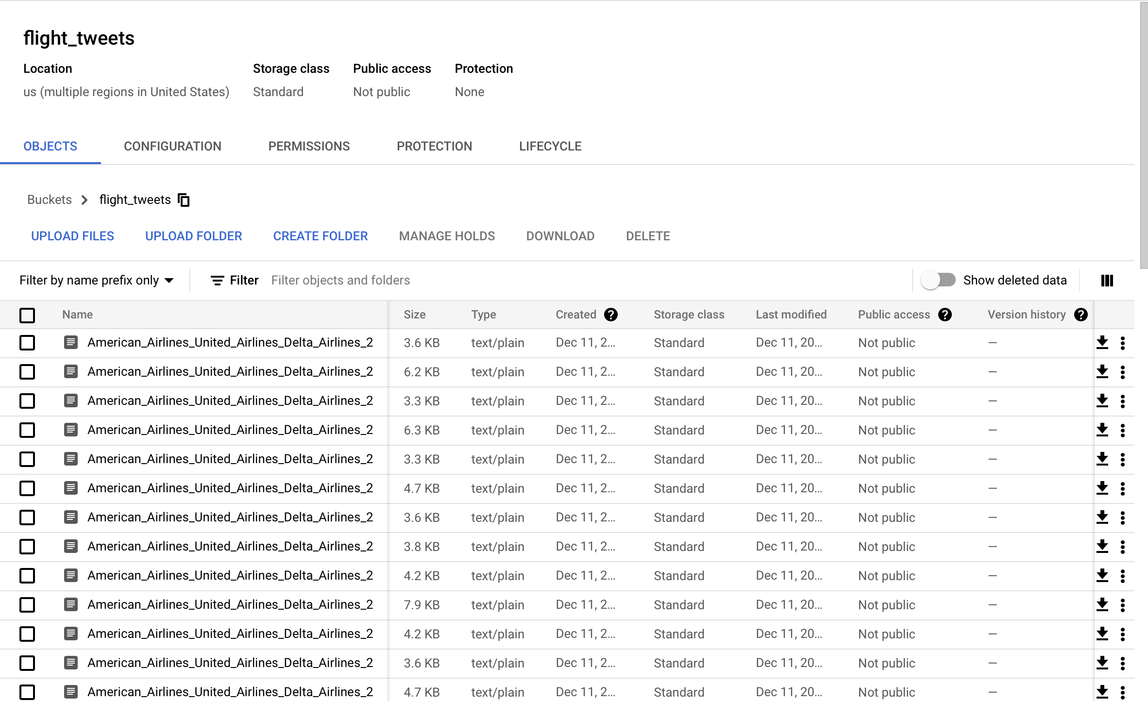
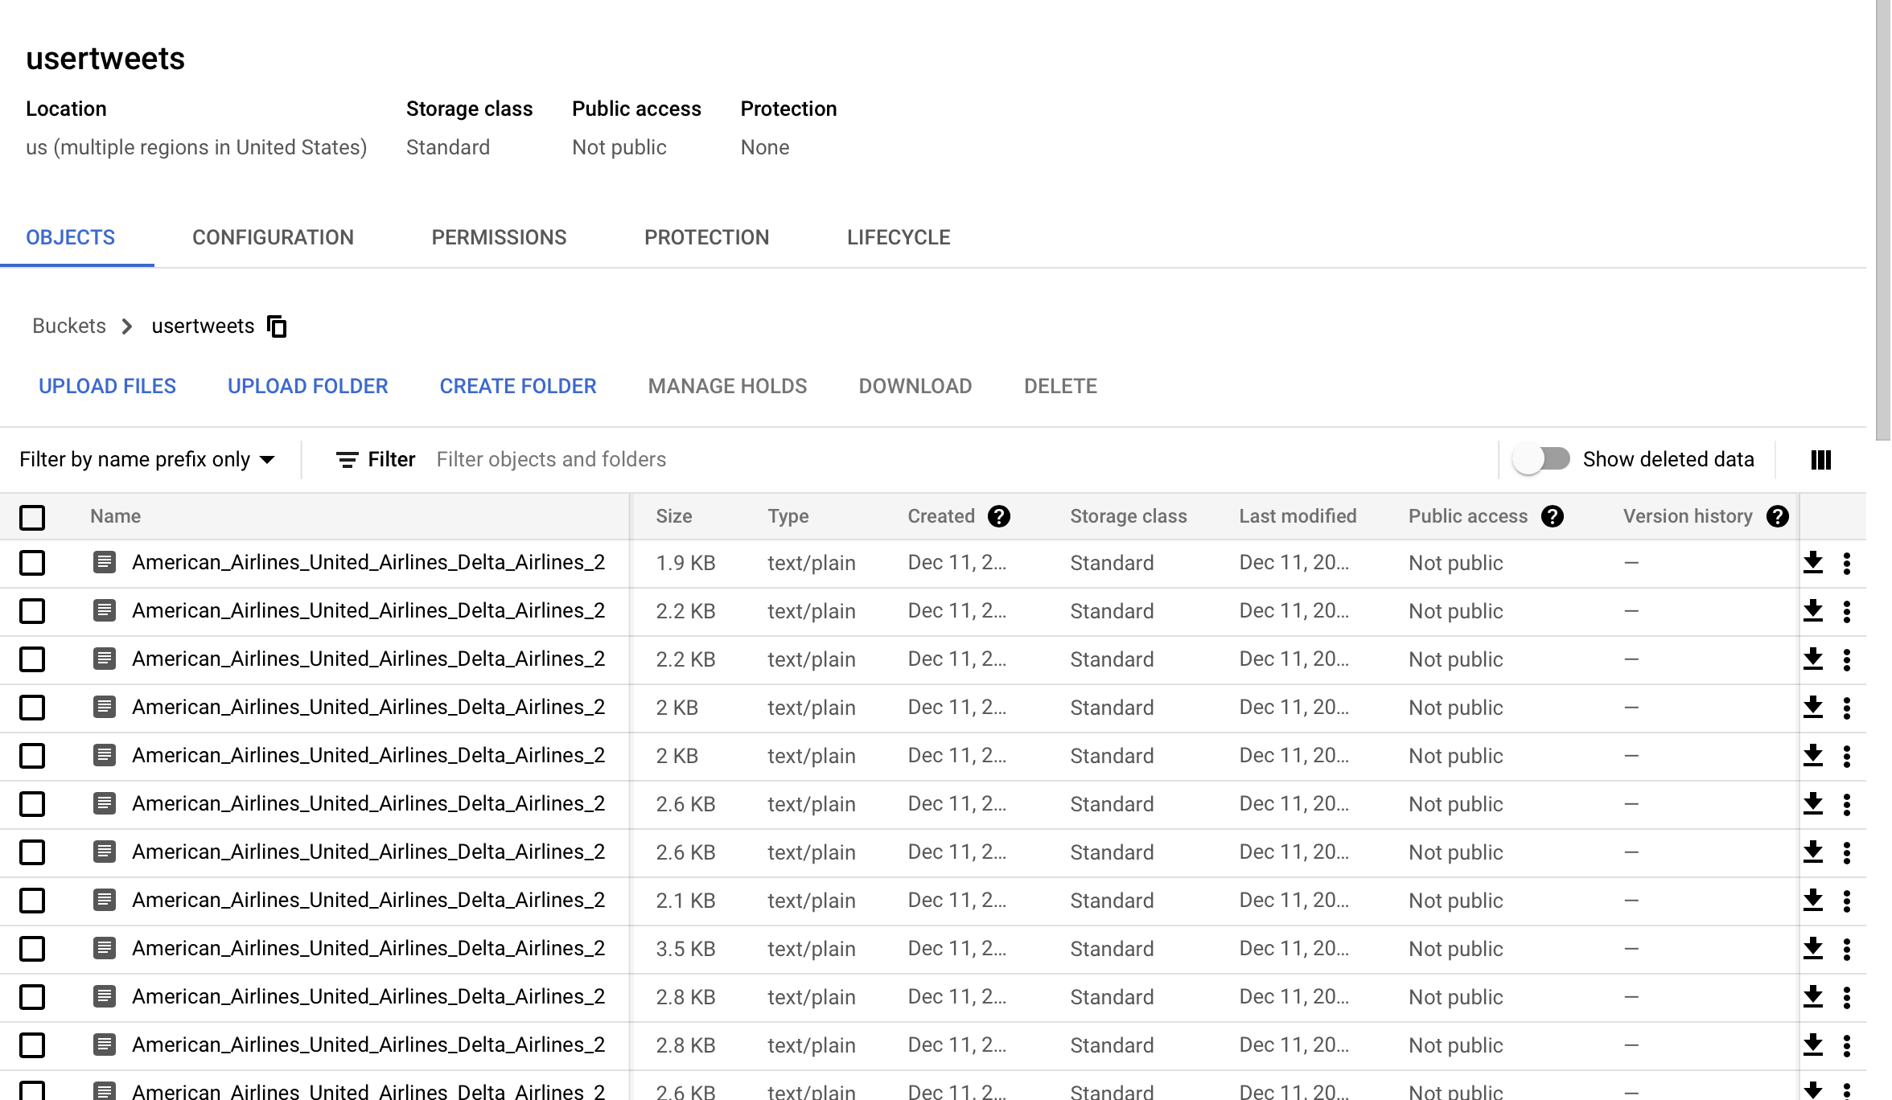
Bucket flight_tweets and usertweets was created

Slide 4
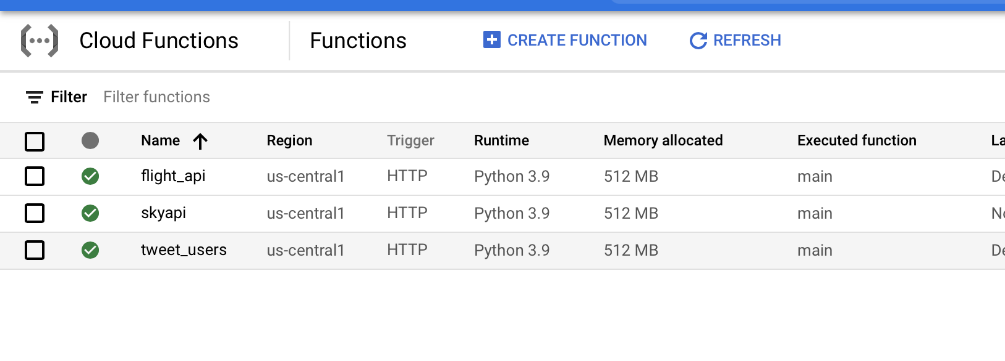
Cloud Function flight_api and Tweet_USers was created & deployed- To retrieve information from TWITTER API

Slide 5
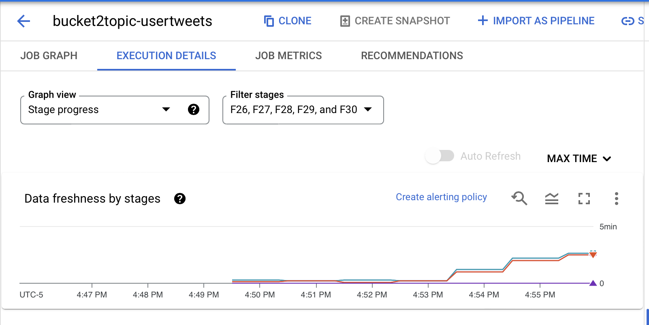
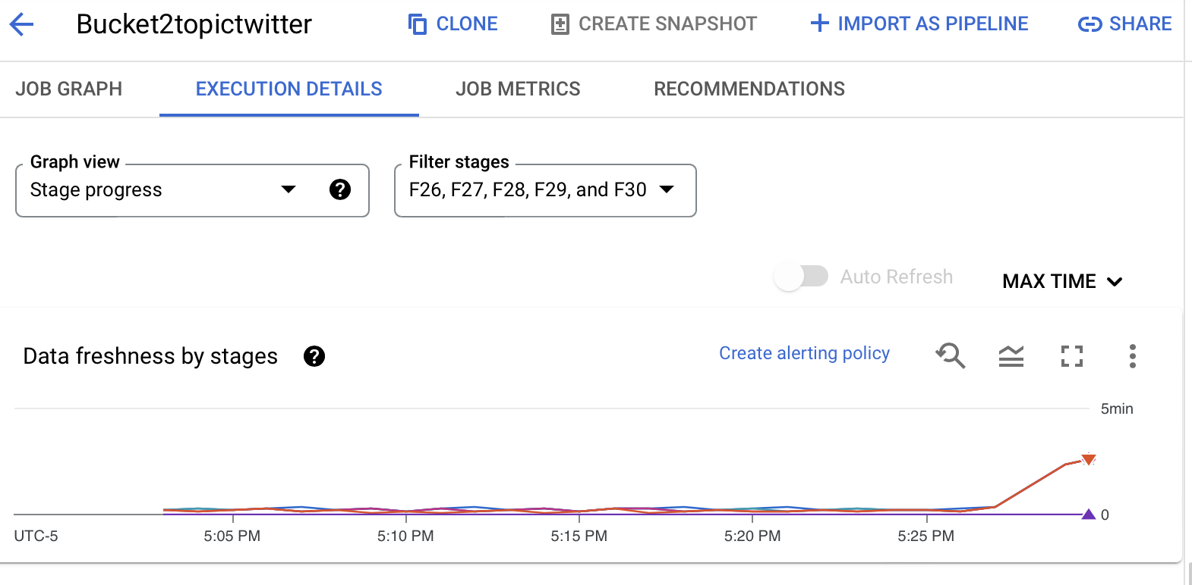
Streaming Dataflow Job BUCKET2topictwitter and BUCKET2topic-USERTWEETS was scheduled to move the data from storage to Pub/Sub Topic

Slide 6
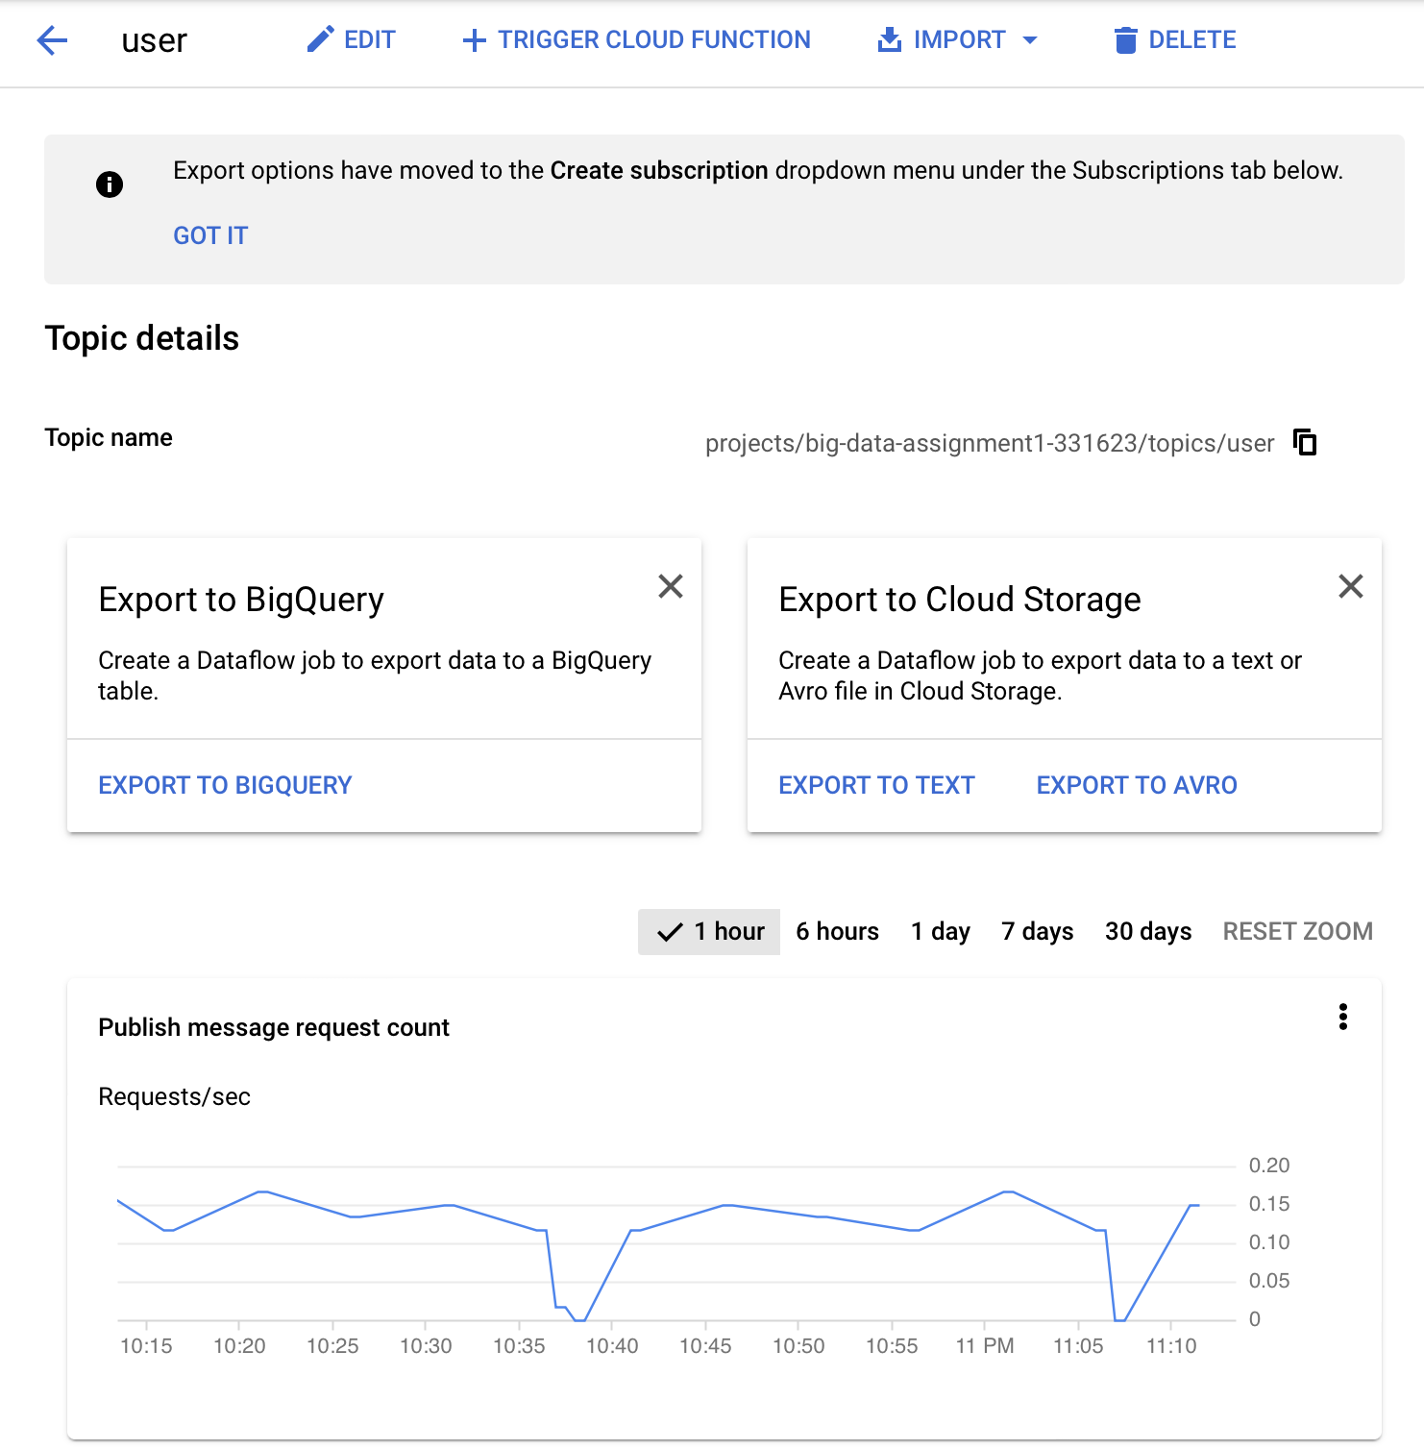
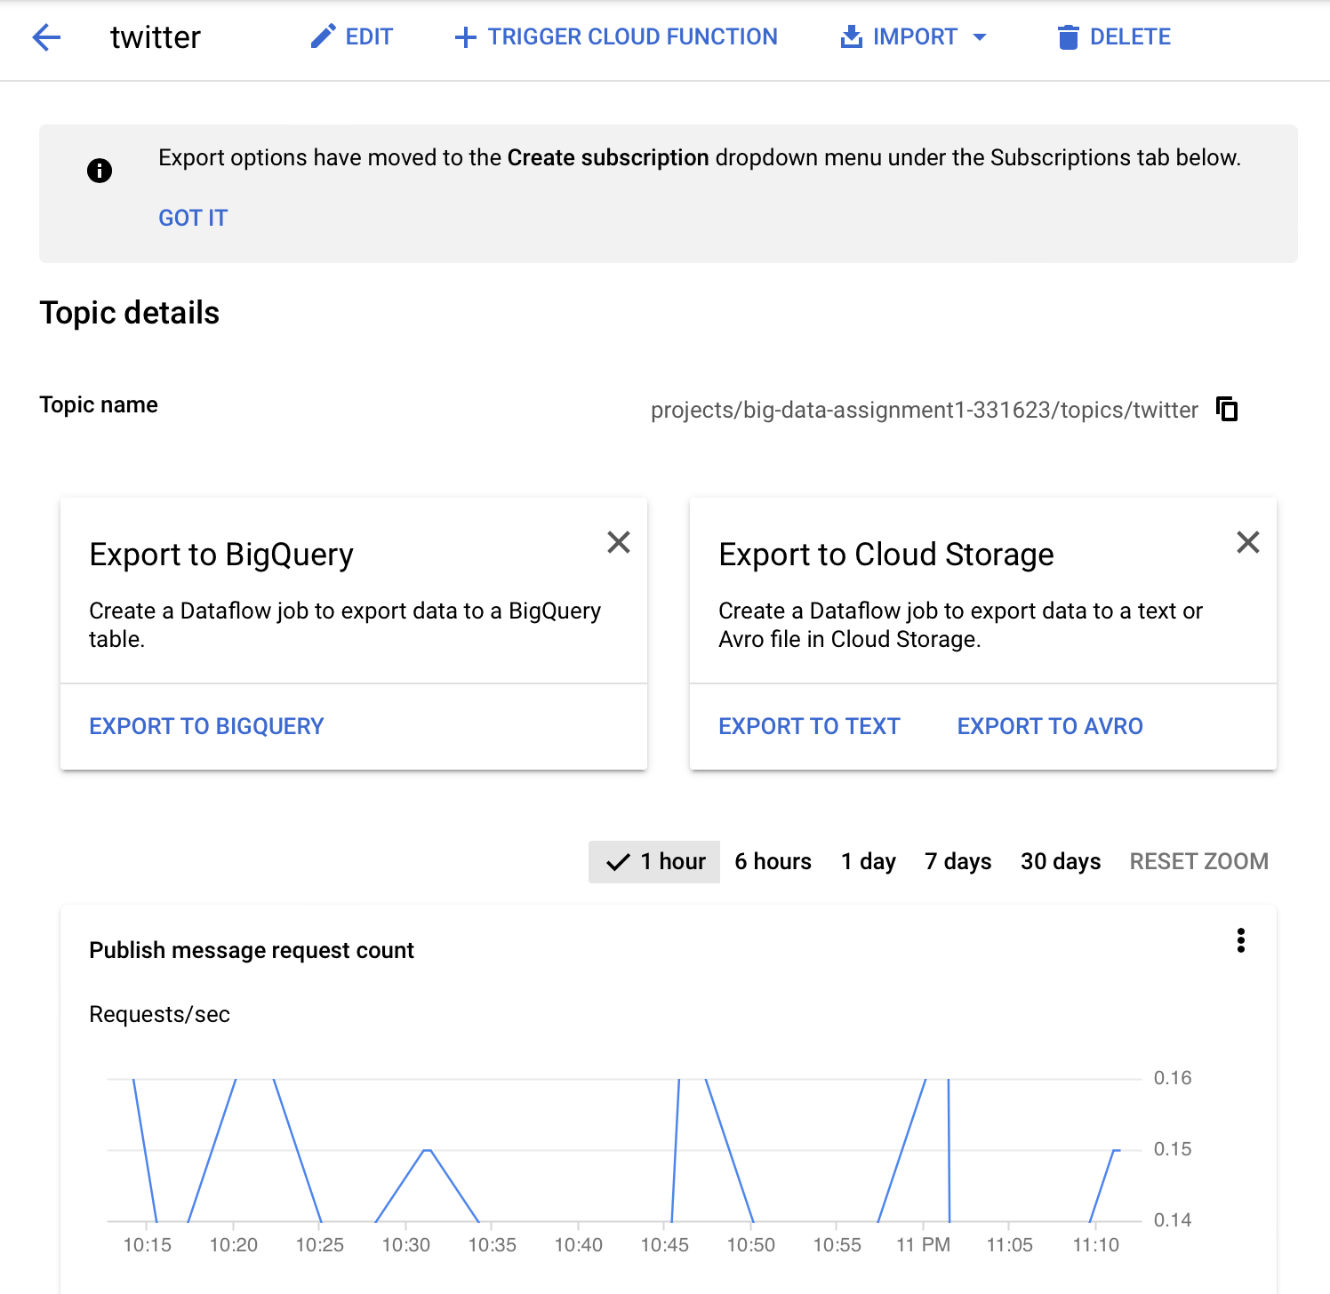
A Pub/Sub Topic TWITTER AND USER was created to move the data from Pub/Sub to Big Query

Slide 7
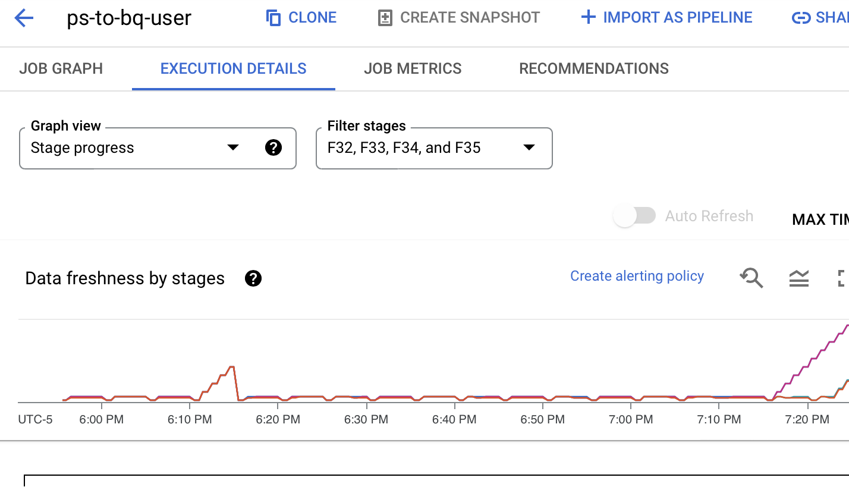
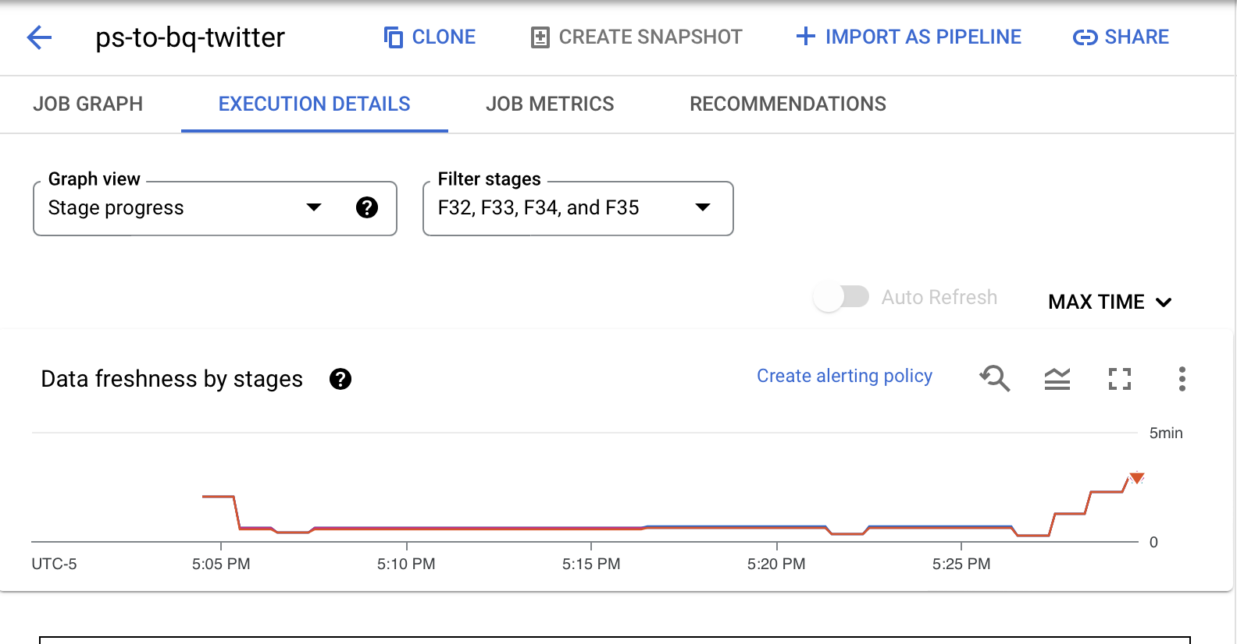
Streaming Dataflow Job ps-to-bq-USER AND ps-to-bq-TWITTER was scheduled to move the data from Pub/Sub Topic to Big Query

Slide 8
Streaming Dataflow Job ps-to-bq-USER AND ps-to-bq-TWITTER was scheduled to move the data from Pub/Sub Topic to Big Query

Slide 9
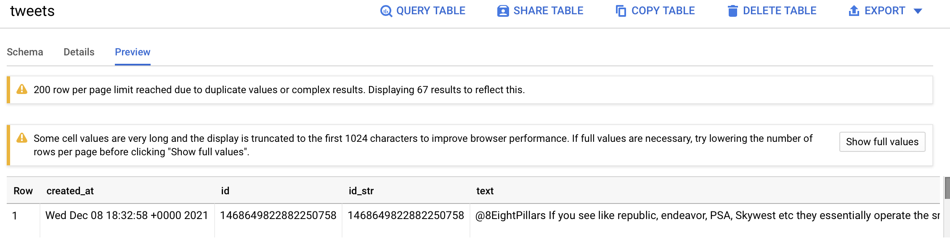
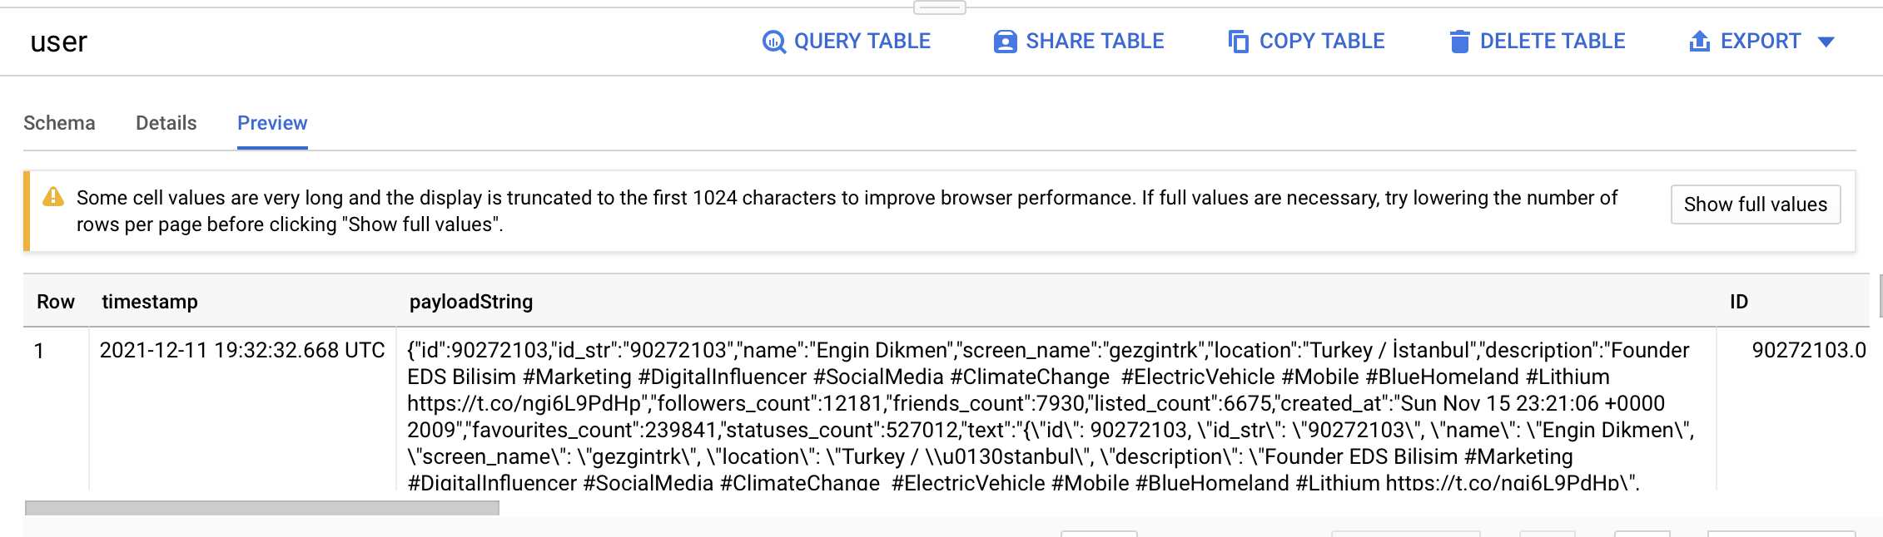
Data from Pub/Sub was flowing to Big Query Table tweets and

Slide 10
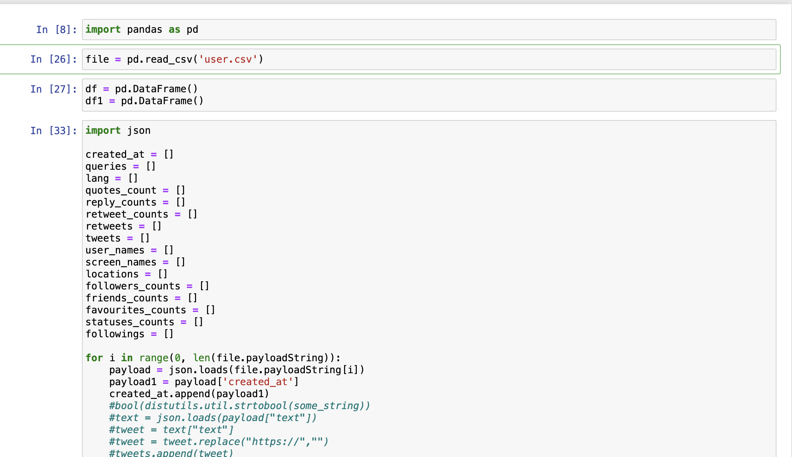
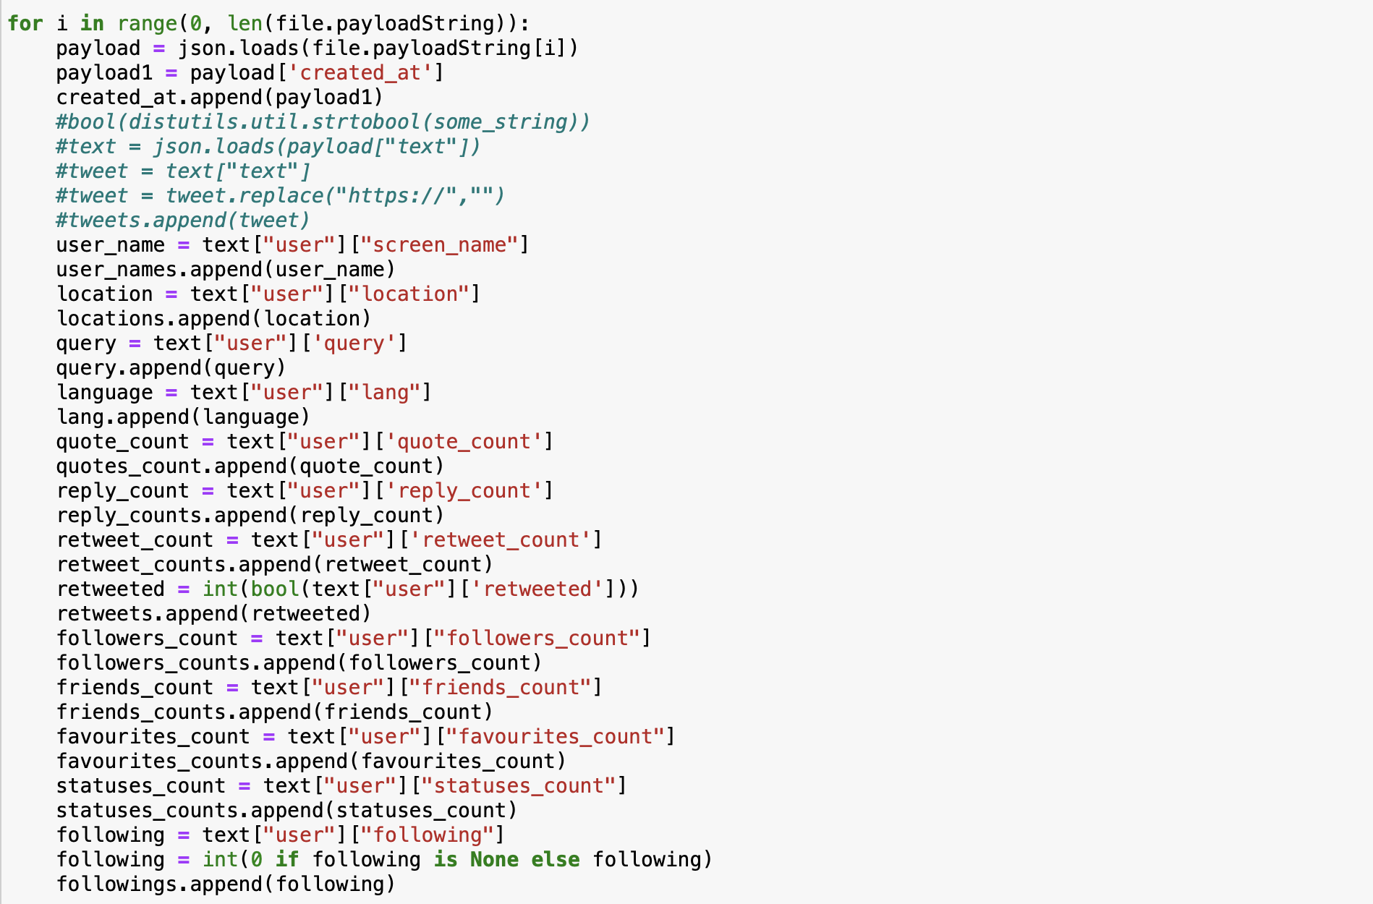
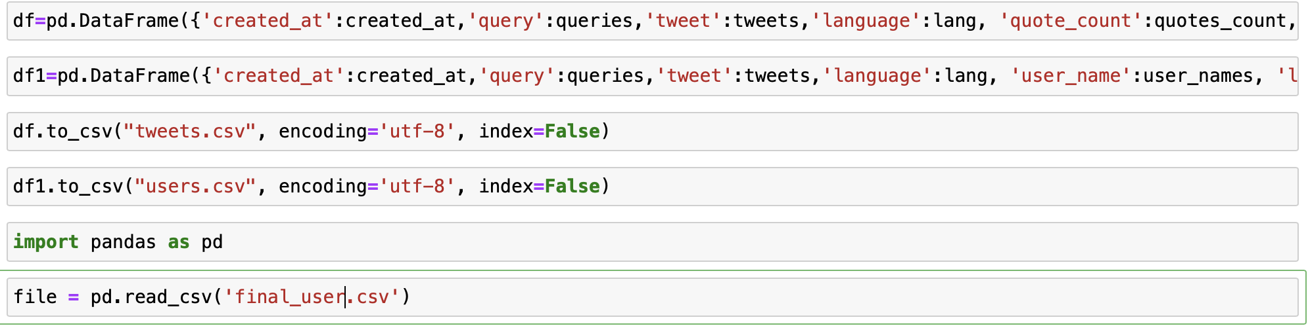
Further Cleaning of USER Data

Slide 11

Analyze tweets to find out flights that are delayed for the routes selected in assignment 2

Slide 12
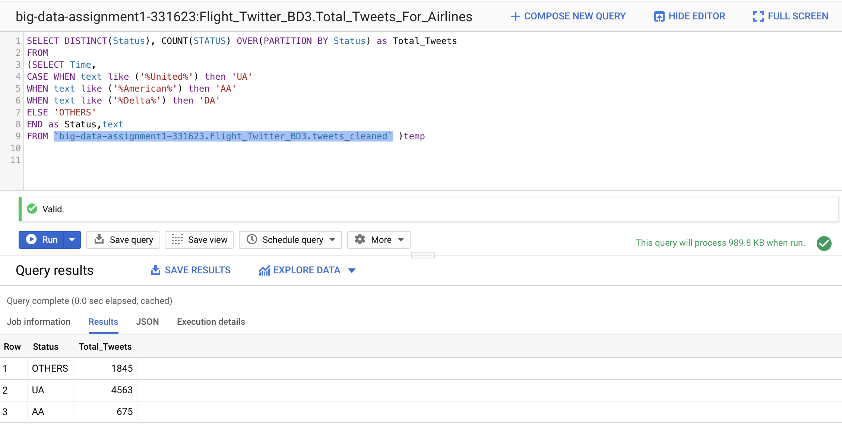
Total Tweets made on airlines
SELECT DISTINCT(Status), COUNT(STATUS) OVER(PARTITION BY Status) as Total_Tweets
FROM
(SELECT Time,
CASE WHEN text like ('%United%') then 'UA'
WHEN text like ('%American%') then 'AA'
WHEN text like ('%Delta%') then 'DA'
ELSE 'OTHERS'
END as Status,text
FROM `big-data-assignment1-331623.Flight_Twitter_BD3.tweets_cleaned` )temp

Slide 13
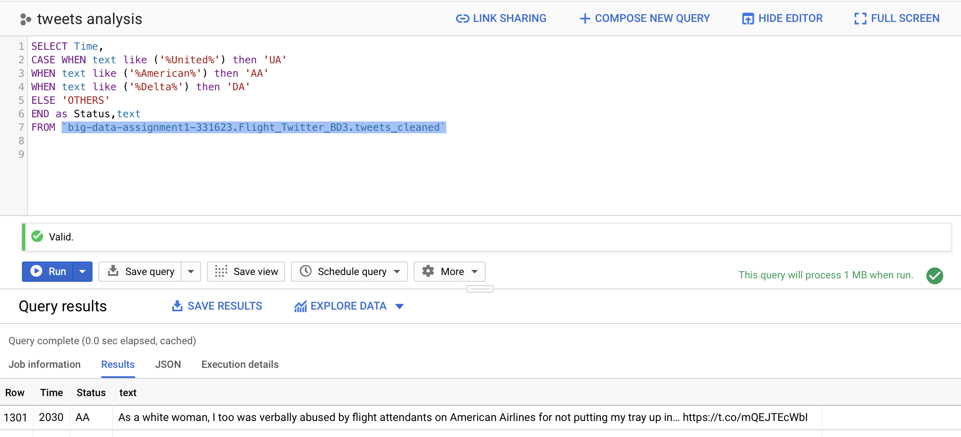
TWEETS AND TEXT ANALYSIS made on airlines
SELECT Time,
CASE WHEN text like ('%United%') then 'UA'
WHEN text like ('%American%') then 'AA'
WHEN text like ('%Delta%') then 'DA'
ELSE 'OTHERS'
END as Status,text
FROM `big-data-assignment1-331623.Flight_Twitter_BD3.tweets_cleaned`

Slide 14
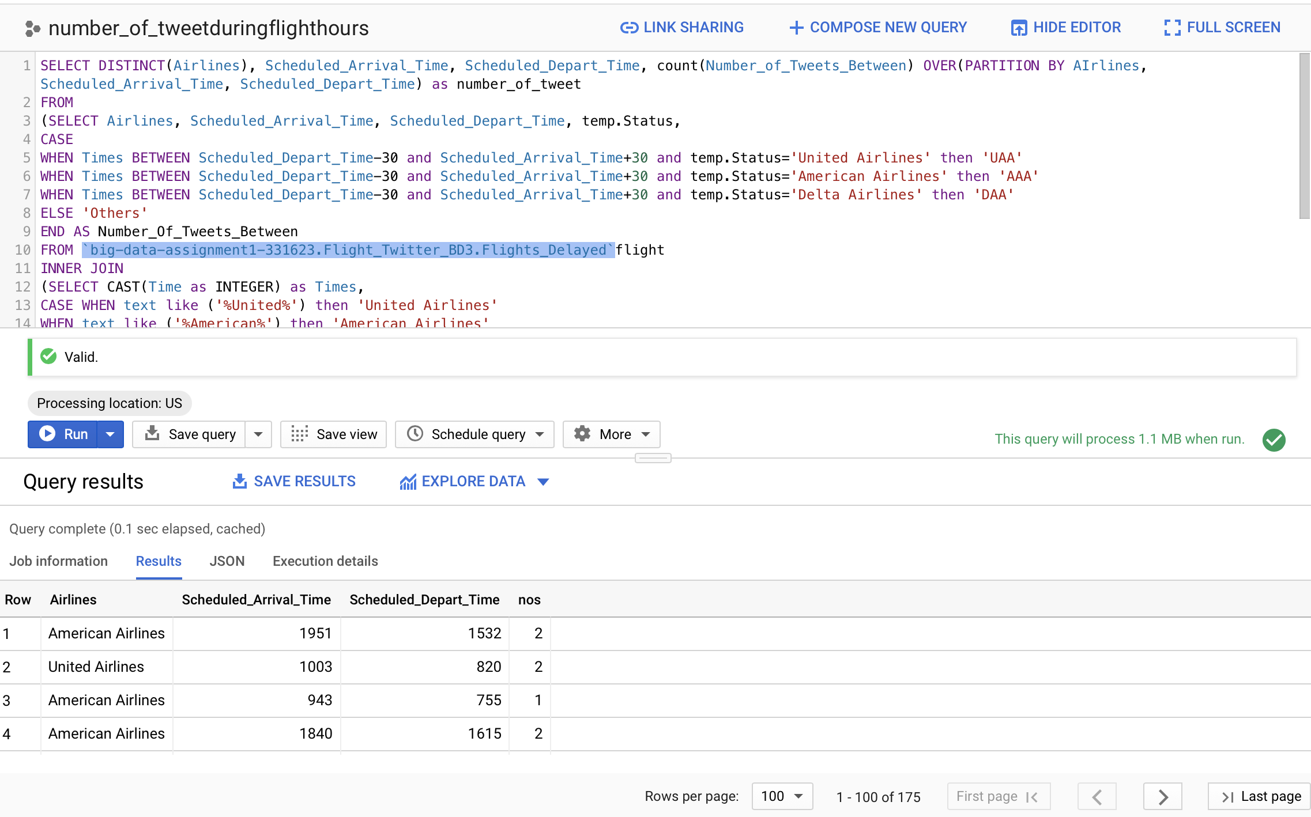
TWEETS MADE DURING FLIGHT HOURS
SELECT DISTINCT(Airlines), Scheduled_Arrival_Time, Scheduled_Depart_Time, count(Number_of_Tweets_Between) OVER(PARTITION BY AIrlines, Scheduled_Arrival_Time, Scheduled_Depart_Time) as number_of_tweet
FROM
(SELECT Airlines, Scheduled_Arrival_Time, Scheduled_Depart_Time, temp.Status,
CASE
WHEN Times BETWEEN Scheduled_Depart_Time-30 and Scheduled_Arrival_Time+30 and temp.Status='United Airlines' then 'UAA'
WHEN Times BETWEEN Scheduled_Depart_Time-30 and Scheduled_Arrival_Time+30 and temp.Status='American Airlines' then 'AAA'
WHEN Times BETWEEN Scheduled_Depart_Time-30 and Scheduled_Arrival_Time+30 and temp.Status='Delta Airlines' then 'DAA'
ELSE 'Others'
END AS Number_Of_Tweets_Between
FROM `big-data-assignment1-331623.Flight_Twitter_BD3.Flights_Delayed`flight
INNER JOIN
(SELECT CAST(Time as INTEGER) as Times,
CASE WHEN text like ('%United%') then 'United Airlines'
WHEN text like ('%American%') then 'American Airlines'
WHEN text like ('%Delta%') then 'Delta Airlines'
ELSE 'OTHERS'
END as Status,text
FROM `big-data-assignment1-331623.Flight_Twitter_BD3.tweets_cleaned`)temp
ON flight.Airlines=temp.Status
WHERE predicted_On_Time='Delayed')
GROUP BY Airlines, Scheduled_Arrival_Time, Scheduled_Depart_Time,Number_of_Tweets_Between

Slide 15
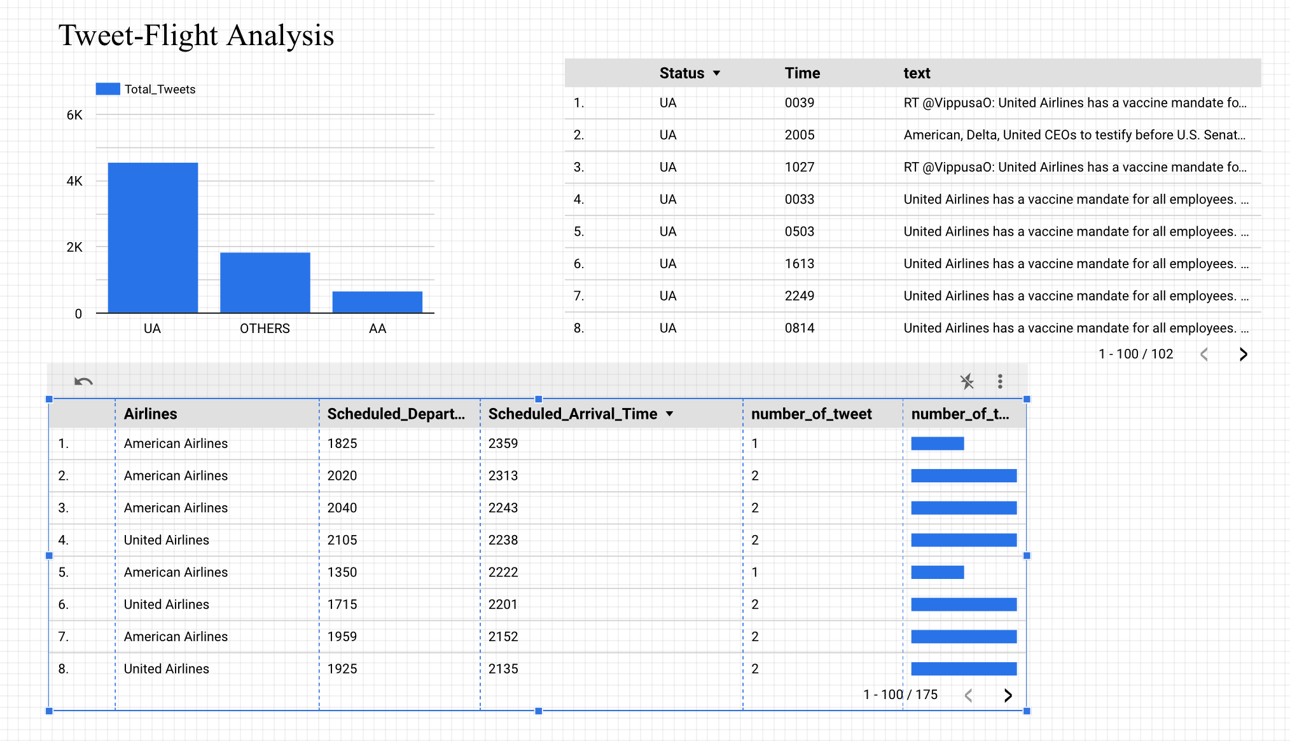
From the Twitter streaming data, we can see that more than 4,500 tweets were completed on United Airlines, followed by other airlines. Compared with United Airlines, American Airlines received fewer tweets. We found that Delta Air Lines had zero tweets.
In the second table, we can see the tweets made by people with respect to Airlines and at what time. Therefore, we can analyse the data and see if the tweet is related to the airline operating the flight..
In the third table, we can see the number of tweets between flight duration and airline name. Thus, helping us further to analyze the sentiments of the passengers with respect to the Airline and their flight

Slide 16
Find the locations of the aircrafts for those FLIGHTS

Slide 17
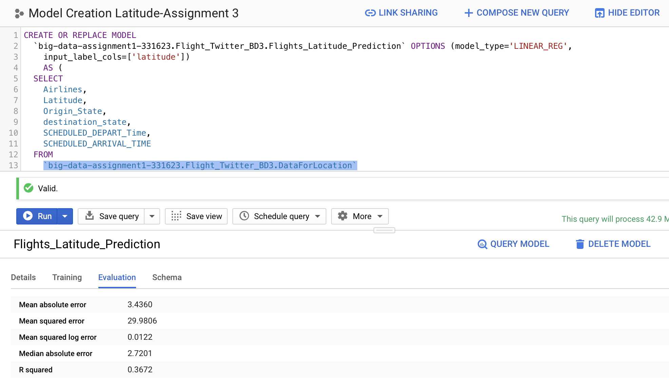
Training Model For Latitude-R-Squared 0.3672
CREATE OR REPLACE MODEL
`big-data-assignment1-331623.Flight_Twitter_BD3.Flights_Latitude_Prediction` OPTIONS (model_type='LINEAR_REG',
input_label_cols=['latitude'])
AS (
SELECT
Airlines,
Latitude,
Origin_State,
destination_state,
SCHEDULED_DEPART_Time,
SCHEDULED_ARRIVAL_TIME
FROM
`big-data-assignment1-331623.Flight_Twitter_BD3.DataForLocation`
WHERE latitude is NOT NULL and longitude is not null)

Slide 18
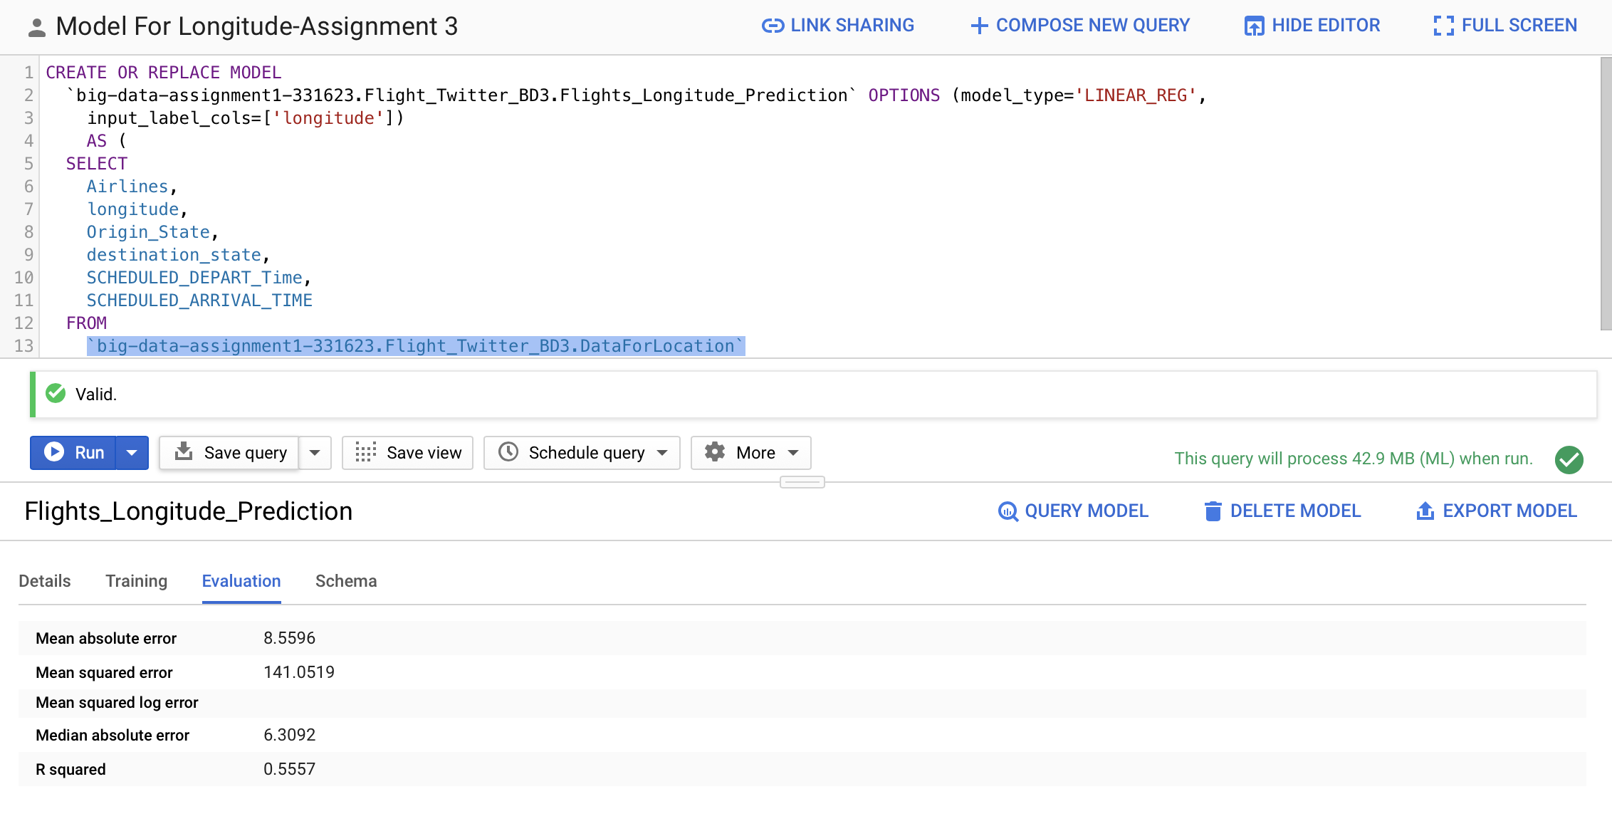
Training Model For Longitude- R-squared 0.5557
CREATE OR REPLACE MODEL
`big-data-assignment1-331623.Flight_Twitter_BD3.Flights_Longitude_Prediction` OPTIONS (model_type='LINEAR_REG',
input_label_cols=['longitude'])
AS (
SELECT
Airlines,
longitude,
Origin_State,
destination_state,
SCHEDULED_DEPART_Time,
SCHEDULED_ARRIVAL_TIME
FROM
`big-data-assignment1-331623.Flight_Twitter_BD3.DataForLocation`
WHERE latitude is NOT NULL and longitude is not null)

Slide 19
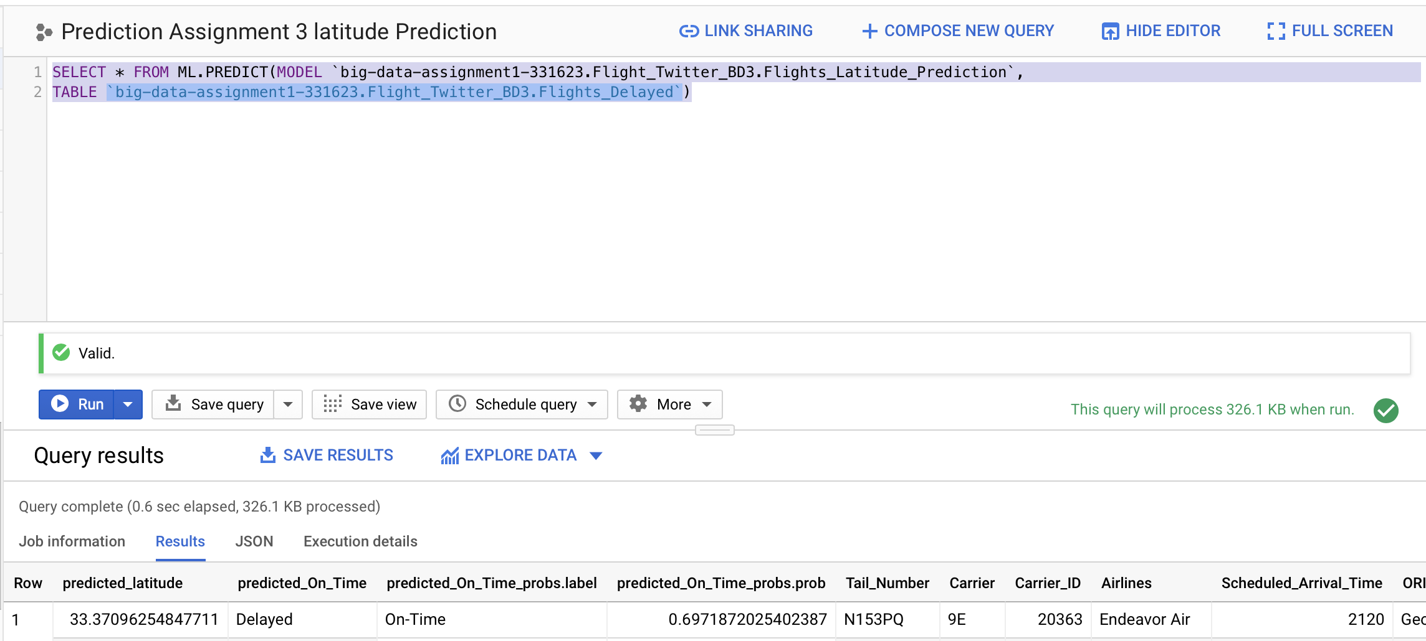
PREDICTING Latitude FOR FLIGHTS
SELECT * FROM ML.PREDICT(MODEL `big-data-assignment1-331623.Flight_Twitter_BD3.Flights_Latitude_Prediction`,
TABLE `big-data-assignment1-331623.Flight_Twitter_BD3.Flights_Delayed`)

Slide 20
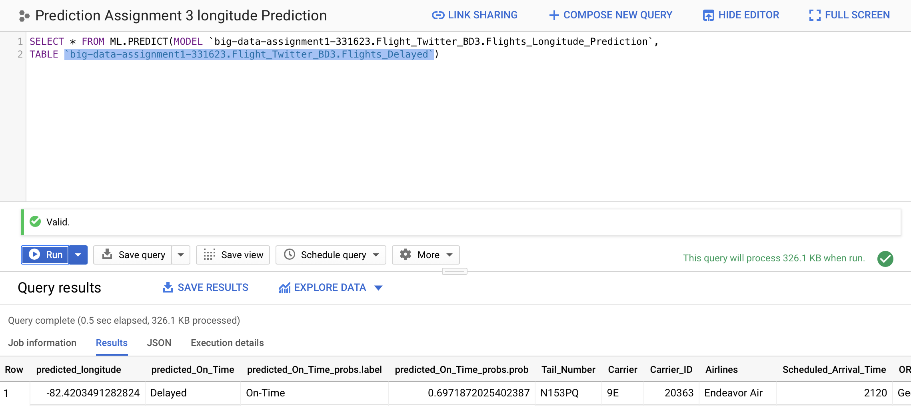
PREDICTING Longitude FOR FLIGHTS
SELECT * FROM ML.PREDICT(MODEL `big-data-assignment1-331623.Flight_Twitter_BD3.Flights_Longitude_Prediction`,
TABLE `big-data-assignment1-331623.Flight_Twitter_BD3.Flights_Delayed`)

Slide 21
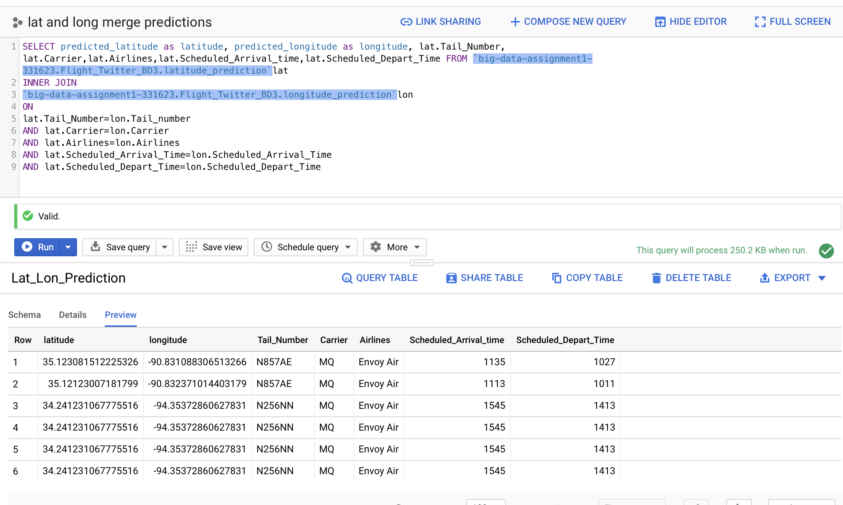
Merging Latitude and Longitude predicted value to form a table
SELECT predicted_latitude as latitude, predicted_longitude as longitude, lat.Tail_Number, lat.Carrier,lat.Airlines,lat.Scheduled_Arrival_time,lat.Scheduled_Depart_Time FROM `big-data-assignment1-331623.Flight_Twitter_BD3.latitude_prediction`lat
INNER JOIN
`big-data-assignment1-331623.Flight_Twitter_BD3.longitude_prediction`lon
ON
lat.Tail_Number=lon.Tail_number
AND lat.Carrier=lon.Carrier
AND lat.Airlines=lon.Airlines
AND lat.Scheduled_Arrival_Time=lon.Scheduled_Arrival_Time
AND lat.Scheduled_Depart_Time=lon.Scheduled_Depart_Time

Slide 22
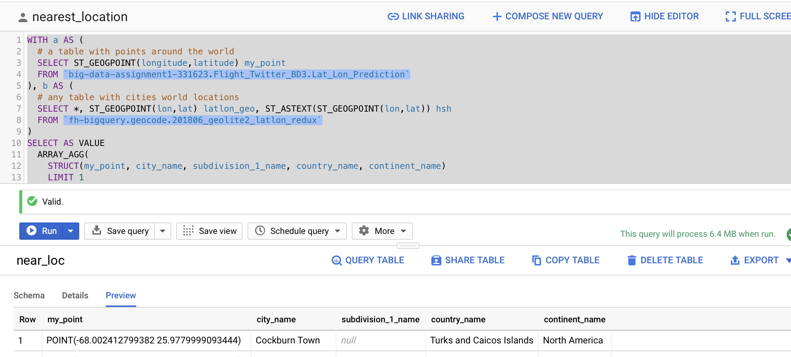
Converting LATITUDE AND LONGITUDE TO GEO-POINTS and RAN QUERY TO FIND CITY NAME, SUBDIVISION, Country, CONTINENT
WITH a AS (
# a table with points around the world
SELECT ST_GEOGPOINT(longitude,latitude) my_point
FROM `big-data-assignment1-331623.Flight_Twitter_BD3.Lat_Lon_Prediction`
), b AS (
# any table with cities world locations
SELECT *, ST_GEOGPOINT(lon,lat) latlon_geo, ST_ASTEXT(ST_GEOGPOINT(lon,lat)) hsh
FROM `fh-bigquery.geocode.201806_geolite2_latlon_redux`
)
SELECT AS VALUE
ARRAY_AGG(
STRUCT(my_point, city_name, subdivision_1_name, country_name, continent_name)
LIMIT 1
)[OFFSET(0)]
FROM (
SELECT my_point, ST_ASTEXT(closest) hsh
FROM a, (SELECT ST_UNION_AGG(latlon_geo) arr FROM b),
UNNEST([ST_CLOSESTPOINT(arr, my_point)]) closest
)
JOIN b
USING(hsh)
GROUP BY ST_ASTEXT(my_point)

Slide 23
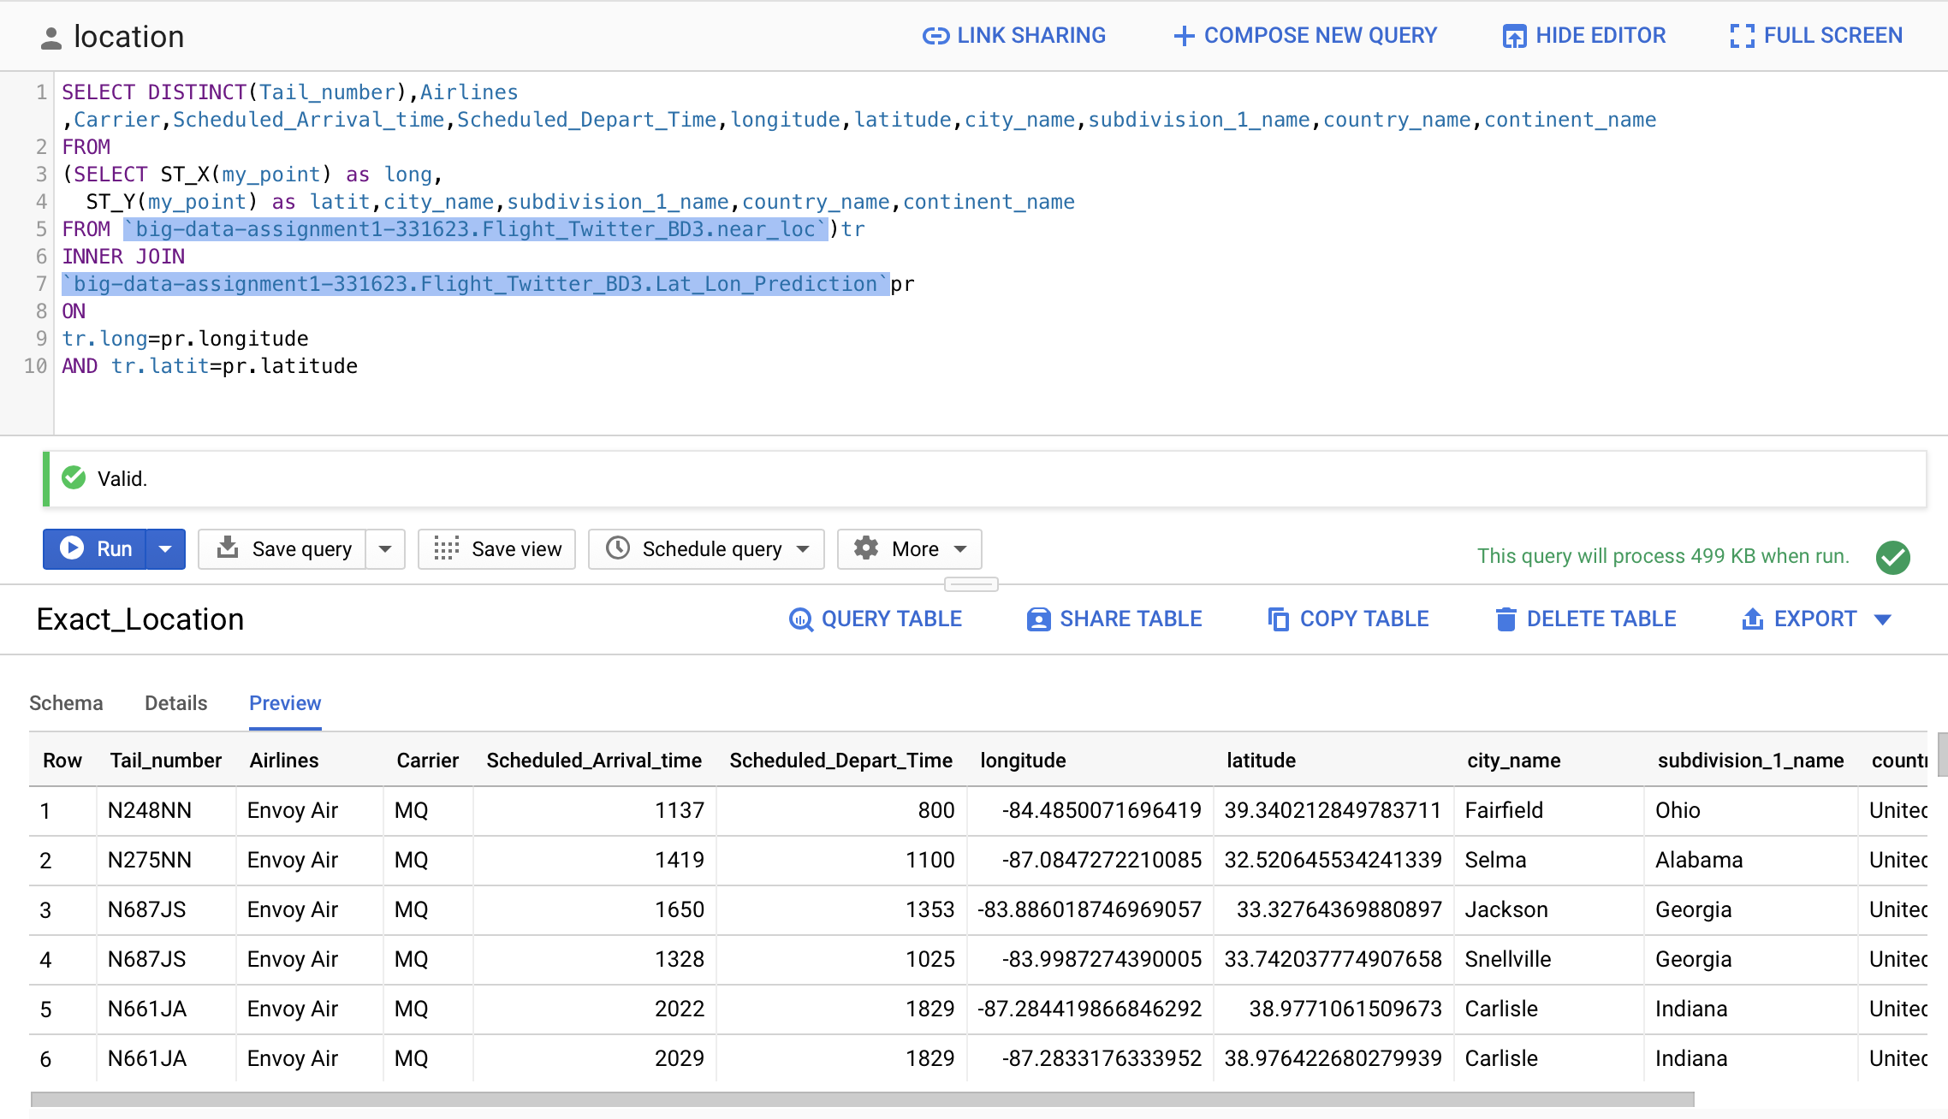
FINAL TABLE WITH airline and location details
SELECT DISTINCT(Tail_number),Airlines ,Carrier,Scheduled_Arrival_time,Scheduled_Depart_Time,longitude,latitude,city_name,subdivision_1_name,country_name,continent_name
FROM
(SELECT ST_X(my_point) as long,
ST_Y(my_point) as latit,city_name,subdivision_1_name,country_name,continent_name
FROM `big-data-assignment1-331623.Flight_Twitter_BD3.near_loc`)tr
INNER JOIN
`big-data-assignment1-331623.Flight_Twitter_BD3.Lat_Lon_Prediction`pr
ON
tr.long=pr.longitude
AND tr.latit=pr.latitude

Slide 24
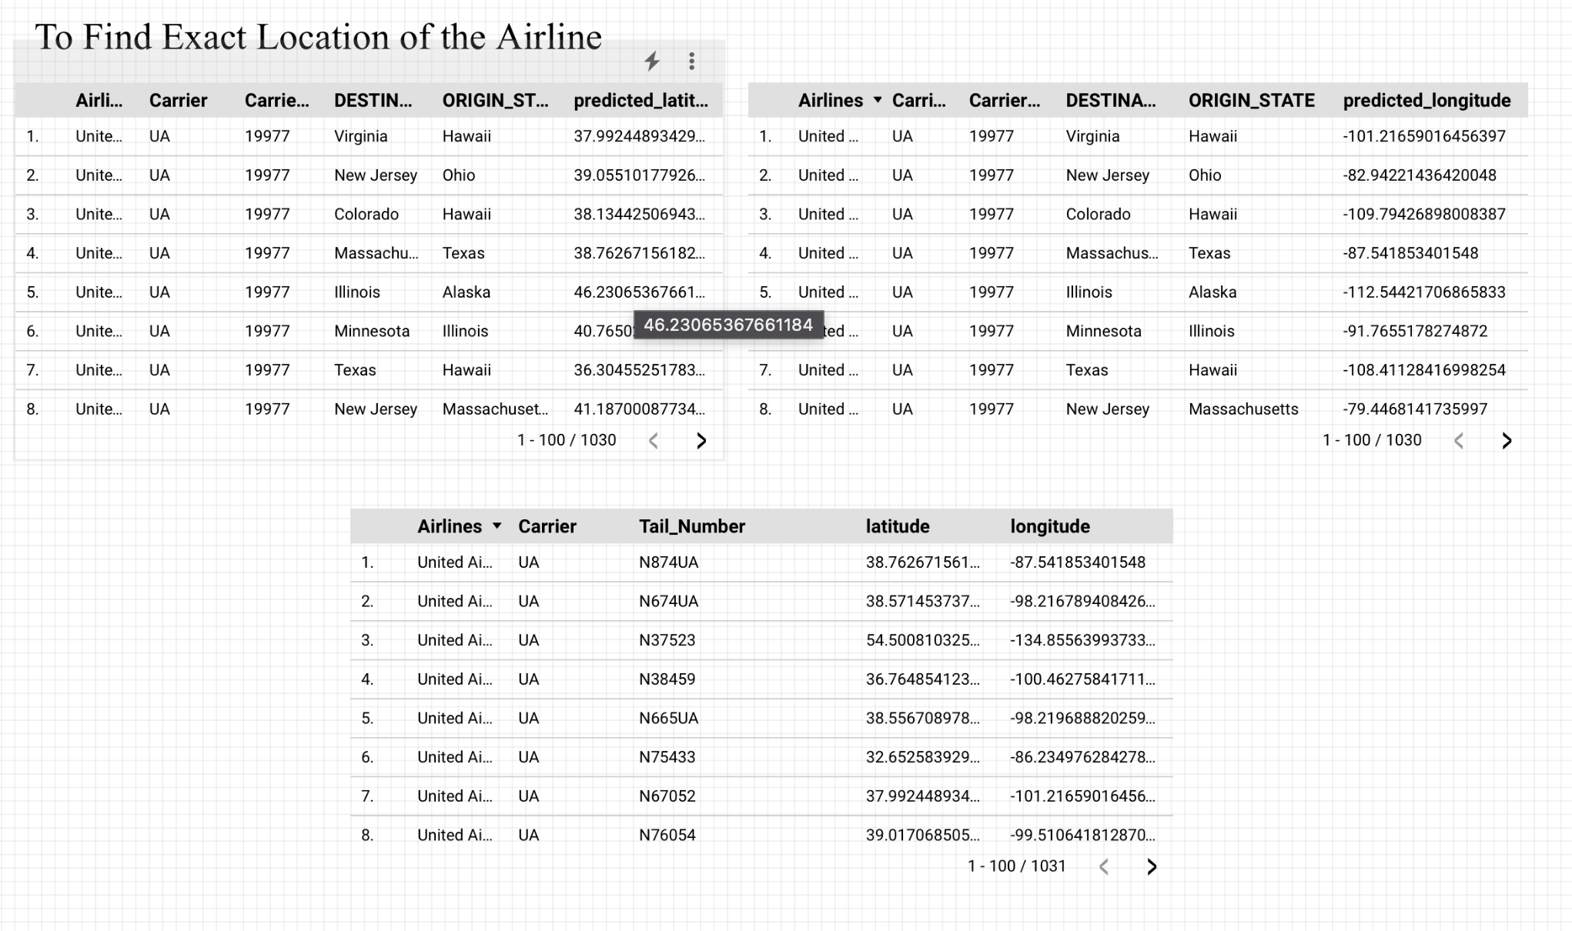
We use the archived data and the predicted latitude and longitude of the streaming data to train our model. After converting the location to a GEO point, we also immediately found out the exact location of the carrier, and then used GEO code data to find out the city, subregion, country, and continent.

Slide 25
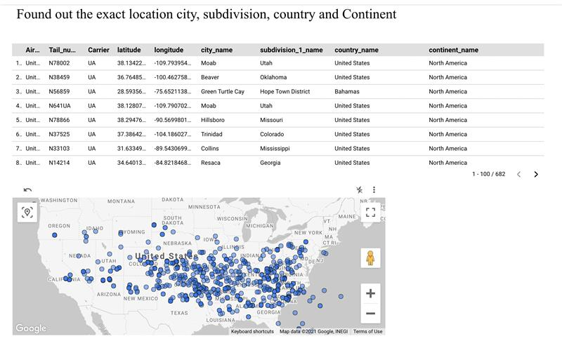
From the table below, we can see the latitude and longitude of cities, regions, countries, and continents. The below map gives a visual representation of the flights operating through the United states. From the picture, we can see that most of the flights are near major cities

Slide 26
Predict arrival times of those flight

Slide 27
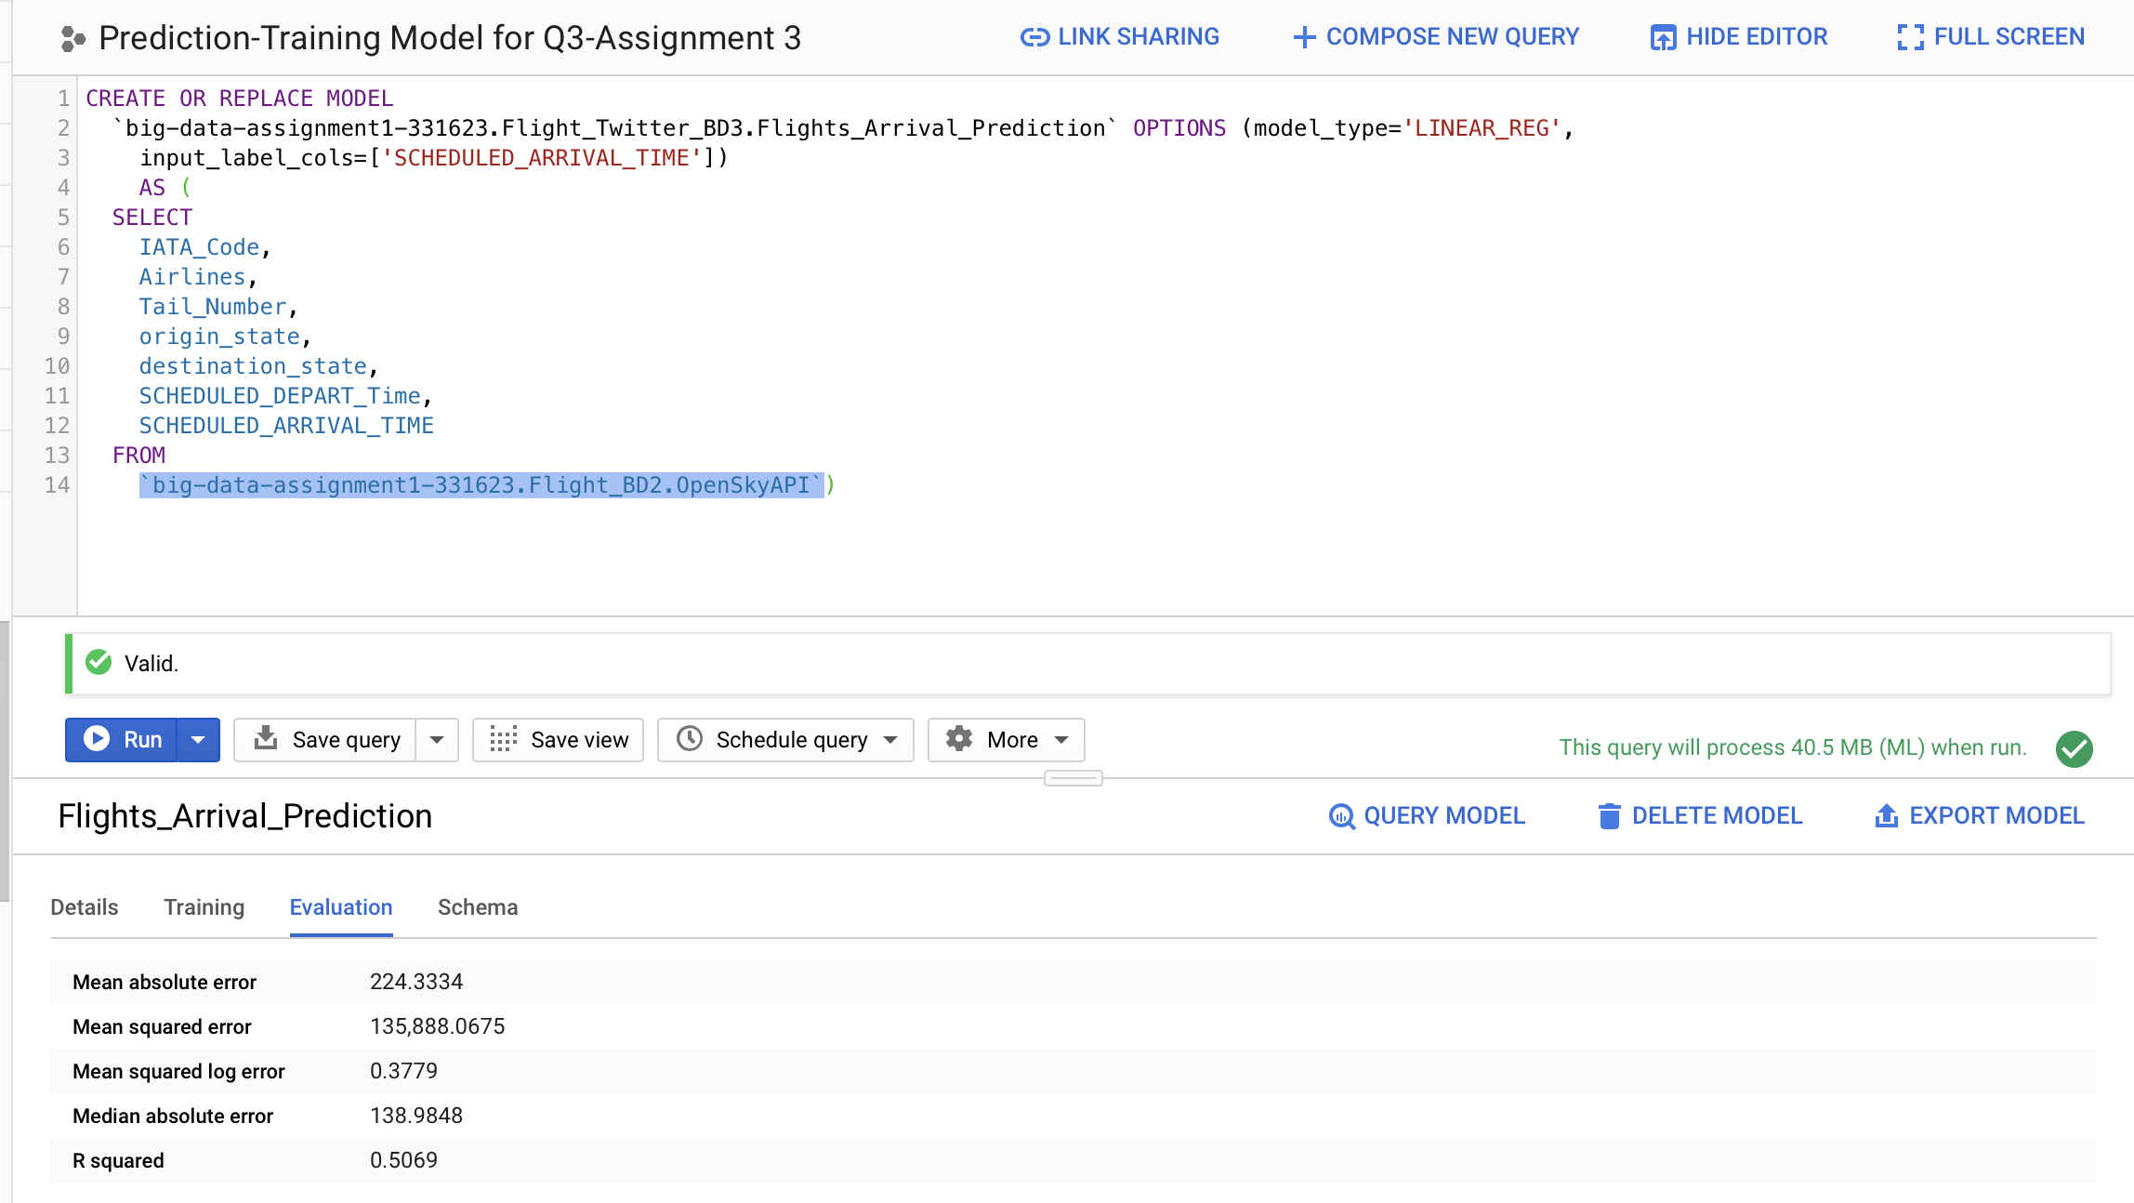
Training Model for Predicting Scheduled Arrival Time R-Squared-0.5069
CREATE OR REPLACE MODEL
`big-data-assignment1-331623.Flight_Twitter_BD3.Flights_Arrival_Prediction` OPTIONS (model_type='LINEAR_REG',
input_label_cols=['SCHEDULED_ARRIVAL_TIME'])
AS (
SELECT
IATA_Code,
Airlines,
Tail_Number,
origin_state,
destination_state,
SCHEDULED_DEPART_Time,
SCHEDULED_ARRIVAL_TIME
FROM
`big-data-assignment1-331623.Flight_BD2.OpenSkyAPI`)

Slide 28
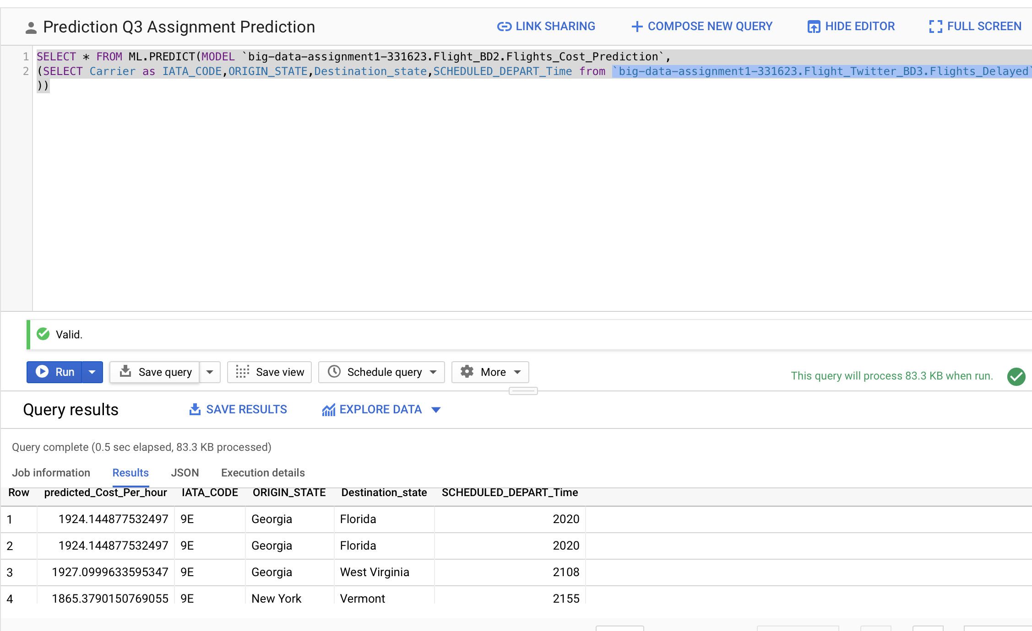
Predicting Scheduled Arrival Time
SELECT * FROM ML.PREDICT(MODEL `big-data-assignment1-331623.Flight_BD2.Flights_Cost_Prediction`,
(SELECT Carrier as IATA_CODE,ORIGIN_STATE,Destination_state,SCHEDULED_DEPART_Time from `big-data-assignment1-331623.Flight_Twitter_BD3.Flights_Delayed` ))

Slide 29
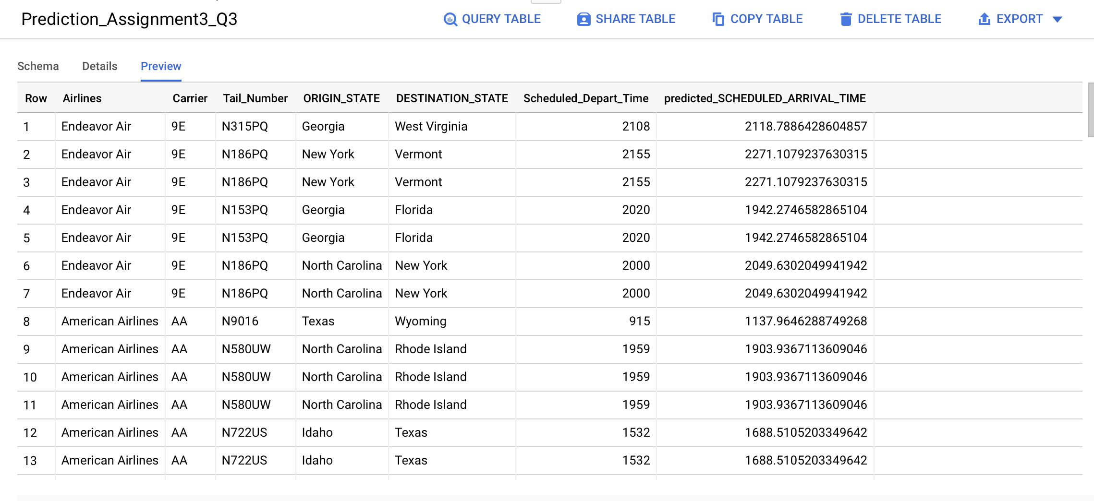
Predicting Scheduled Arrival Time- FINAL TABLE

Slide 30
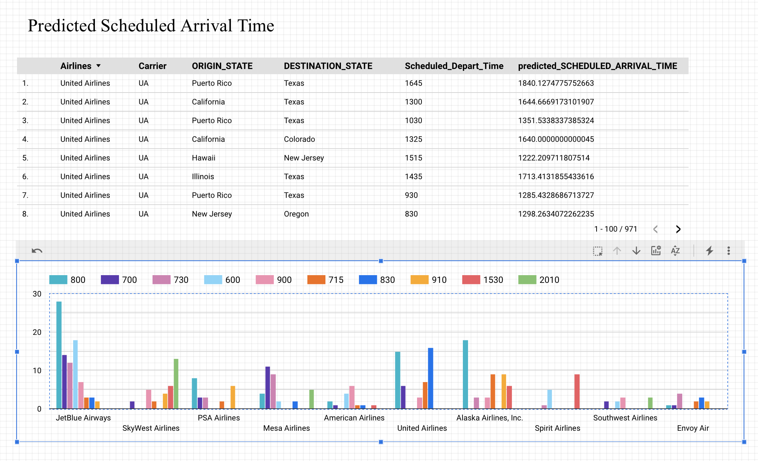
We use archived data to train our model and predict the scheduled arrival time of flight flow data. On analyzing the graph, we can see that for our dataset Jet-Blue has the maximum number of flights arriving at 8 o’clock in the morning,. And over time, the number of flights will decrease. For United, we can also see the same trend. At 8o’clock and 8:30o’clock, it has the maximum number of flights, which will arrive at the airport. Spirit Airlines has the least number of flights compared to others.

Slide 31
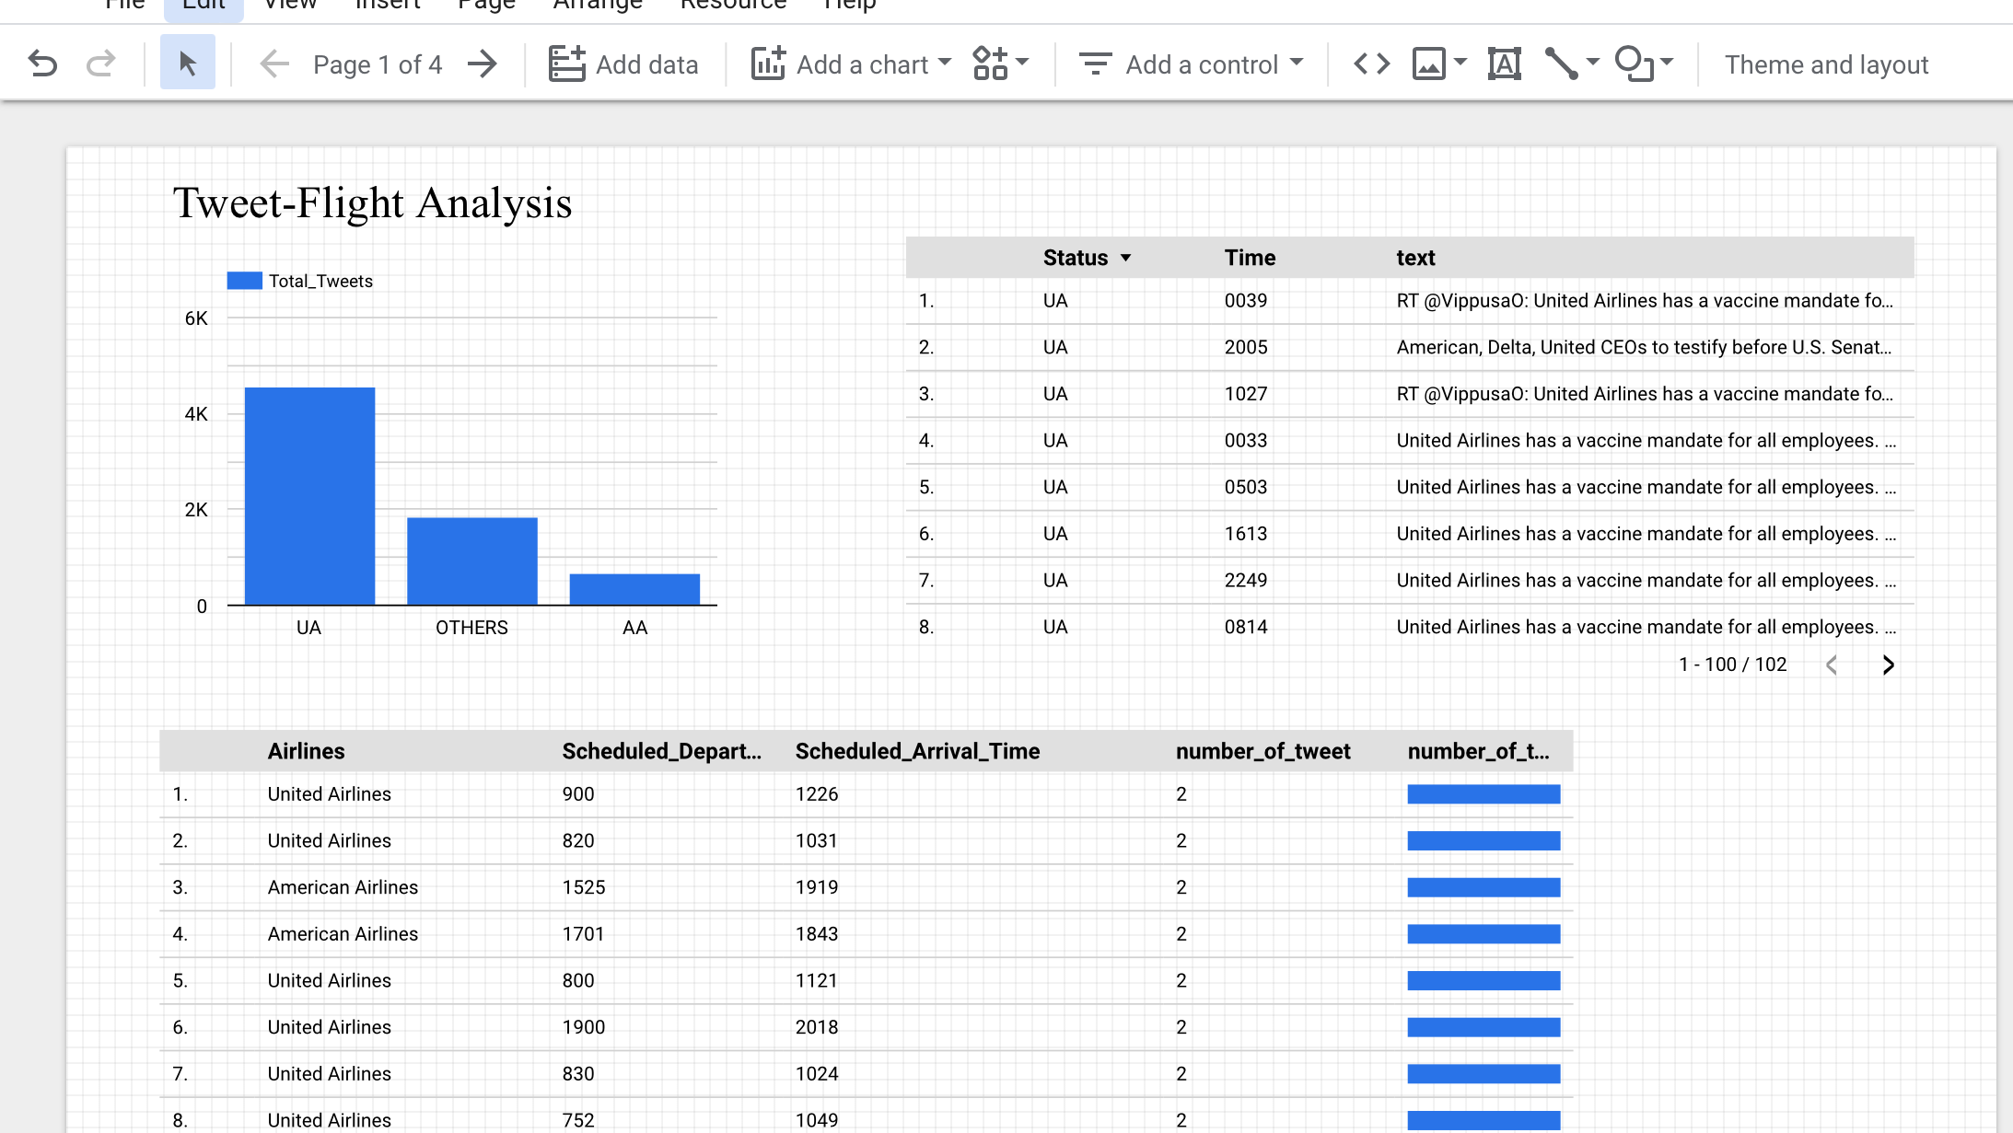
Dashboard

Slide 32
Team Contribution
Snigdha Rudola- SQL Queries , Visualization and PPT for “Analyze tweets to find out flights that are delayed for the routes you selected in assignment 2”
Jonathan Reji Mathai - SQL Queries , Visualization and PPT for “Analyze tweets to find out flights that are delayed for the routes you selected in assignment 2”
Shubham Agarwal- SQL Queries, Visualization and PPT for for “Find the locations of the aircrafts for those flights or origin-destination pairs.”, Creation of Dashboard and Analysis
Nityanand Kowtha - SQL Queries , Visualization and PPT for “Analyze tweets to find out flights that are delayed for the routes you selected in assignment 2”
Rajib Mahato- Data cleaning, Downloading Additional Table, SQL Queries, Visualization and PPT for “Find the locations of the aircrafts for those flights or origin-destination pairs” and “Predict arrival or departure times of those flight”.
DASHBOARD LINK- https://datastudio.google.com/reporting/c933036b-085e-43a2-befb-8e045a1beb6e/page/20ZhC/

